Slide 1


CROP YIELD PREDICTION
K.Lakshmi Sri
P.Poojitha
A.Jyoshna Sree
S.Amrutha

Slide 2
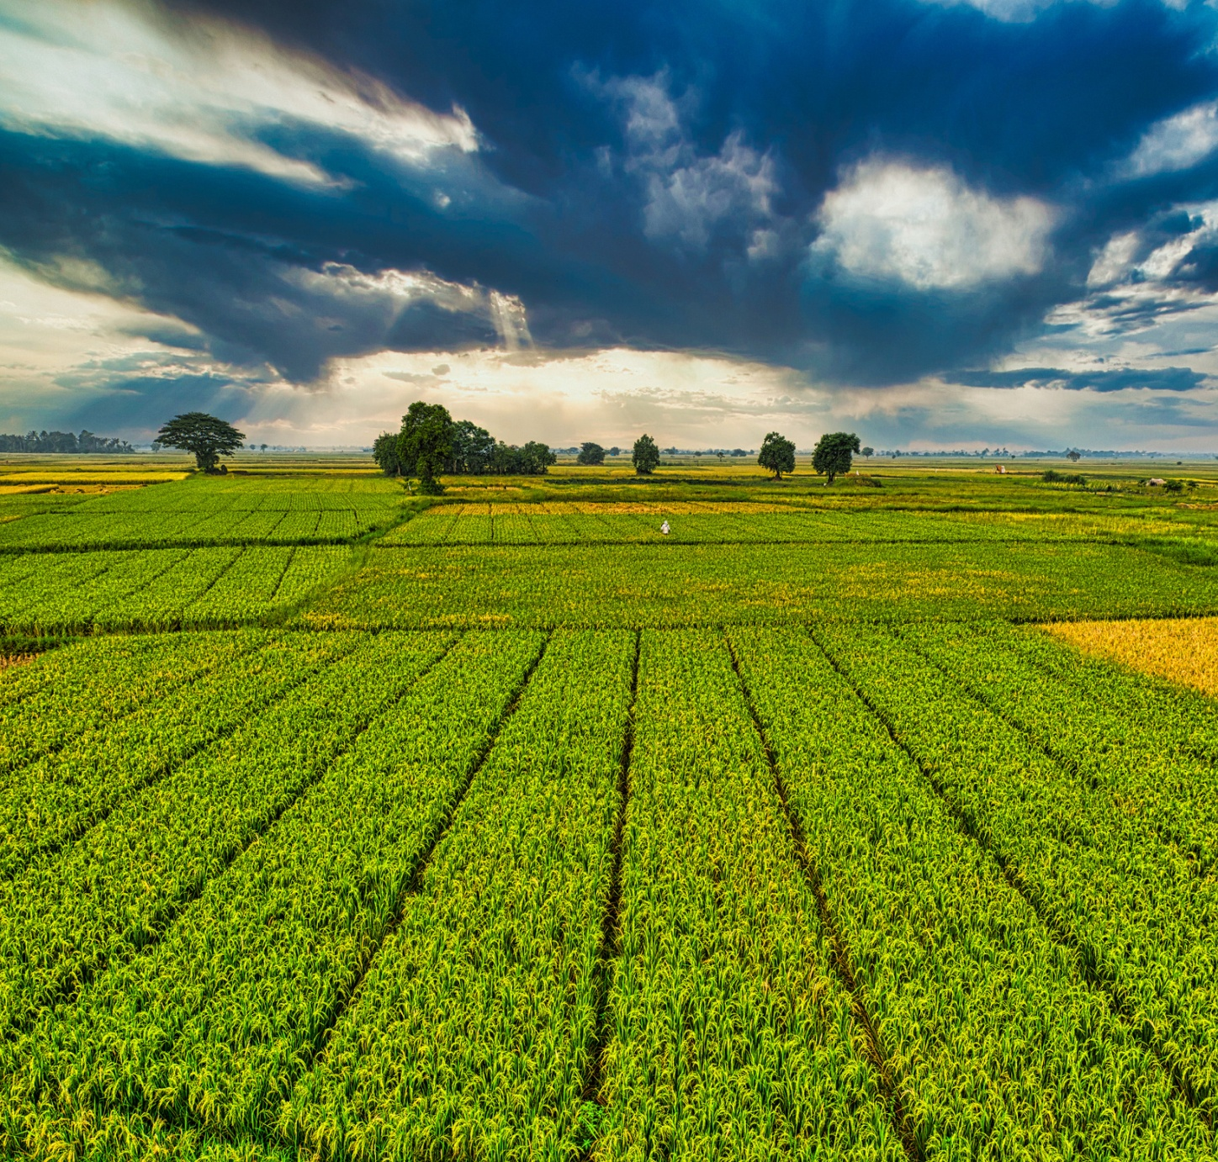
Project Overview
1.INTRODUCTION
2.EXISTING PROJECTS
3.LITERATURE SURVEY TABLE
4.UNDERSTANDING METHODOLOGIES
5.OPTIMIZATION TECHNIQUES
6.SUMMARY OF DATASETS
7.EVALUTION METRICS
5.CONCLUSION

Slide 3
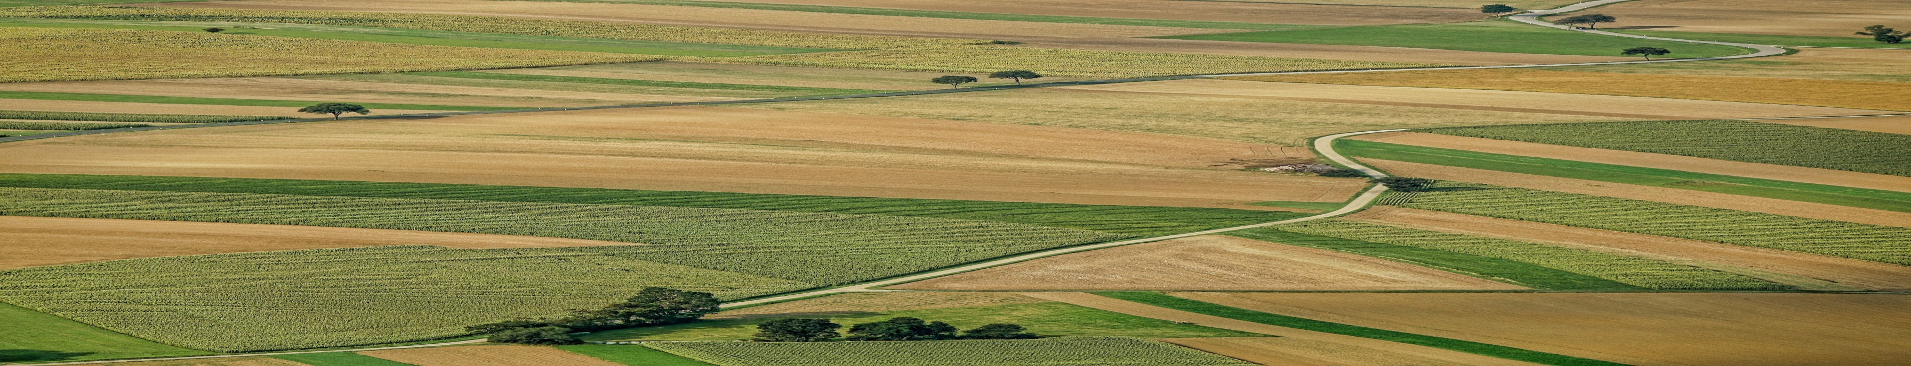
A Crop Yield Predictor is a system that uses data like weather, soil, crop type, and farming practices to predict how much crop will be produced in a given area or season.
It helps:
Farmers plan better for harvesting, irrigation, and fertilizers.
Governments make decisions about food supply and storage.
Companies manage pricing, insurance, and distribution.
INTRODUCTION

Slide 4
EXISTING PROJECTS
Project Type | Core AI/ML Function | Drawbacks / Limitations (Concise)
Crop/Variety Recommendation System | Classification (recommending the best crop) | * Oversimplified: General recommendations fail to capture field-specific micro-variability. * Market Risk: Accuracy depends on highly volatile and complex market price forecasts.
Integrated Precision Farming Platforms | Full-stack prediction, often using multiple models. | * High Cost/Complexity: Requires expensive infrastructure (sensors/drones) and specialized expertise. * Data Integration Issues: Challenging to merge and standardize diverse data streams from multiple sources.
Specific Crop/Region Forecasting | Regression model tuned for a particular crop in a specific geographical area. | * Poor Transferability: Models are not generalizable; they must be retrained for any new region or crop. * Brittle to Extremes: Fails to accurately predict yield under unprecedented or extreme weather conditions.

Slide 5
LITERATURE SURVEY TABLE
Year | Title | Methods & techniques | Accuracy / Performance | Dataset used | Limitations
2024 | Machine Learning-Based Crop Yield Prediction in South India: Performance Analysis of Various Models | Linear Regression, Gradient Boosting, Random Forest, Extra Trees | R² ≈ 0.9615; MAE = 21.06; RMSE = 33.99 for Extra Trees MDPI | Soil+weather+crop data for Indian states (rice, sorghum, cotton) | Region-specific; may not generalize outside studied states
2022 | Crop Yield Prediction Using Machine Learning Models: Case of Irish Potato and Maize | Random Forest, SVR, Polynomial Regression | R² ≈ 0.867 (potato); 0.817 (maize) MDPI | Potato & maize data (Rwanda) + weather variables | Only two crops; limited geographic scope
2024 | Prediction of Best Suitable Crop using Machine Learning Technique | Linear Regression, Random Forest, Gradient Boosting, Stacking/Voting ensembles | Highest R² and lowest RMSE/MAE for hybrid model HSM2 IJISAE | Agronomic + environmental factors dataset (soil, rainfall, temp) | Focus is partly on crop suitability then yield; still region limited
2024 | Naïve Bayes and Random Forest for Crop Yield Prediction | Naïve Bayes, Random Forest, KNN, Linear models | Demonstrated high effectiveness for yield prediction India (1997-2020) arXiv | Indian major crops & environmental factors dataset | Some models simple; may not capture complex interactions

Slide 6
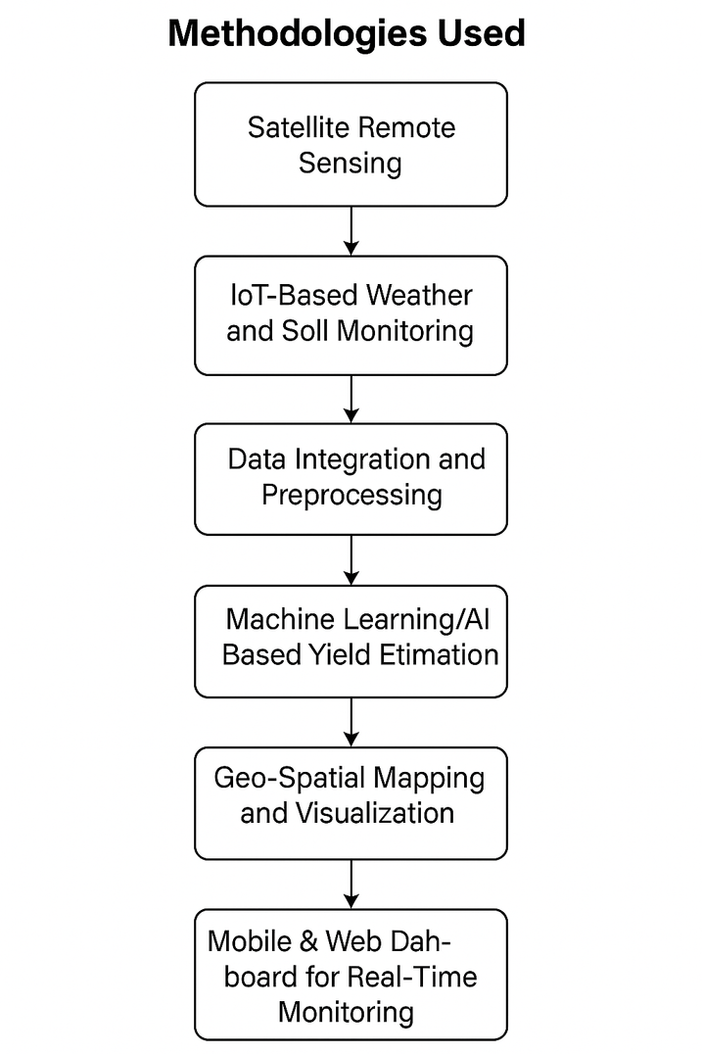
UNDERSTANDING METHODOLOGIES
Year | Title | Methodology
2024 | Machine Learning-Based Crop Yield Prediction in South India: Performance Analysis of Various Models | Compared four regression models (Extra Trees, Random Forest, Gradient Boosting, Linear Regression) with Extra Trees achieving the highest performance.
2022 | Crop Yield Prediction Using Machine Learning Models: Case of Irish Potato and Maize | Applied and compared Random Forest, Support Vector Regression (SVR), and Polynomial Regression models for two specific crops (potato and maize).
2024 | Prediction of Best Suitable Crop using Machine Learning Technique | Employed and optimized a Stacking/Voting Ensemble of multiple regression models (Linear, RF, GB) for both crop suitability and yield prediction.
2022 | Crop Recommendation and Yield Prediction Using Machine Learning Algorithms | Utilized distinct supervised machine learning models for a dual task: classification for crop recommendation and regression for yield prediction.
2021 | Crop Yield Prediction Using Machine Learning Algorithms | Compared the accuracy of simpler models, with Random Forest emerging as the best performer among Logistic Regression and Naive Bayes.
2023 | A Survey on Crop Yield Prediction Using Machine Learning | Conducted a comprehensive review, comparing the application of fundamental machine learning algorithms (KNN, DT, NB, SVM) across various Indian datasets.
2022 | Agriculture Crop Yield Prediction Using ML | Employed various unspecified standard ML regression models to predict crop yield based on generic agronomic and weather datasets.

Slide 7
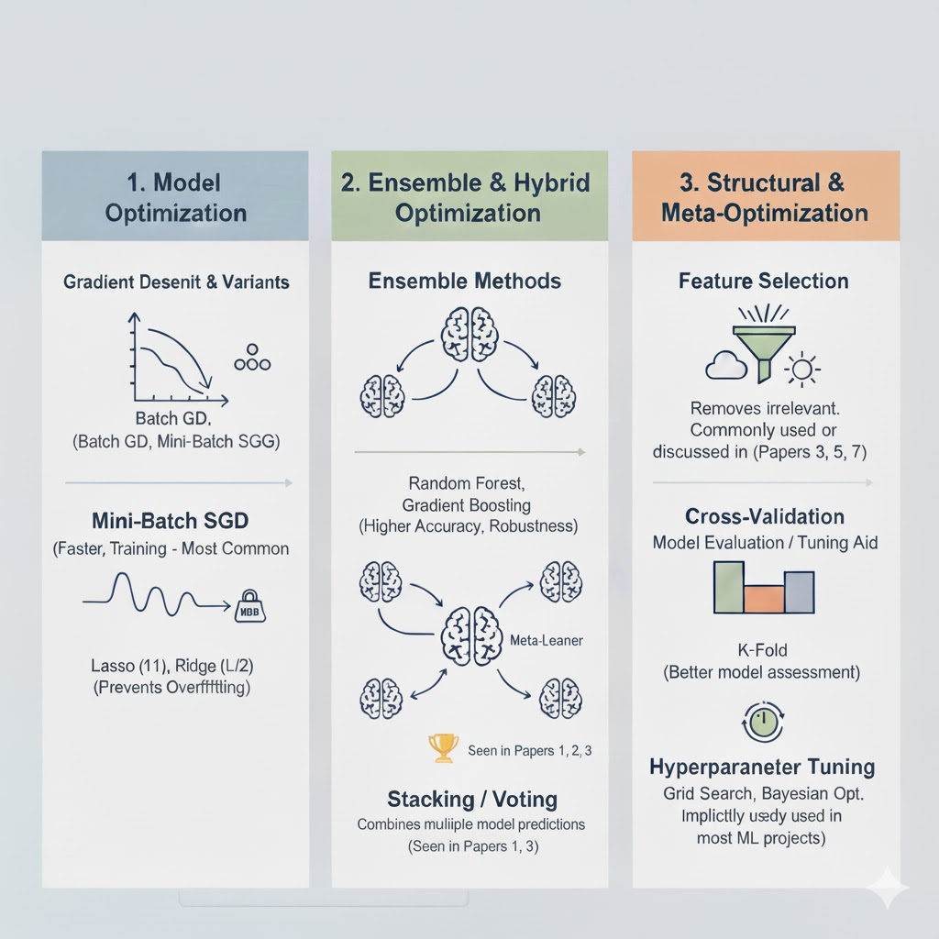
OPTIMIZATION TECHNIQUES
GAPS
Gap (The Problem) | Un-addressed Objective (Our Solution)
1. Not Working Everywhere (Poor Generalizability & Region-Specific Models) | We will build one smart, combined model (Stacking/Voting Ensemble) that works accurately for many different crops and regions.
2. Breaking Down in Bad Weather (Model Brittleness to Extreme Conditions) | We will make the model much tougher by giving it advanced historical data and using the Random Forest method to handle extreme weather effects better.

Slide 8
Summary of datasets
Dataset Name | No. of Records | No. of Features | Balance Check Result | Key Imbalance Details
crop_yield.csv (Aggregated Yield) | 19,689 | 10 | Generally Unbalanced | 55 unique crop types. The most frequent crop (Rice) accounts for approx 6% of the records, indicating high crop diversity.
indiancrop_dataset.csv (Recommendation/ML) | 2,200 | 10 | Generally Unbalanced | 22 unique crop types. The top classes have approx 100$ records each, representing 5% per class. This is a relatively structured split.
Crop_recommendation.csv (Recommendation) | 1,400 | 6 | Potentially Imbalanced | 13 unique crop types. The most frequent class (maize) accounts for 14% of records, showing a more uniform distribution than the larger production datasets.

Slide 9
EVALUTION METRICS
Dataset | Problem Type | Recommended Metrics
crop_yield.csv (Regression) | Yield Prediction | Weighted F1- Score (Primary), $\mathbf{RMSE}$ (Error Magnitude), MAE
Crop_recommendation.csv (Classification) | Crop Type | Weighted F1-Score}$ (Primary), Accuracy, Confusion Matrix
Chemicals and crop damage.csv (Classification) | Damage Severity | Weighted F1-Score}$ (Primary), Cohen's Kappa
Deep Data Fusion & Feature Engineering: Align all data (Crop, Rain, Chem) spatially/temporally; engineer features like Yield, Seasonal Rainfall, and Lagged Variables.
Advanced Ensemble Modeling: Use XGBoost/Random Forest and a Stacking Ensemble to maximize non-linear prediction accuracy.
Mandatory Time-Series Validation: Implement Rolling Origin Cross-Validation to validate model performance on future data and prevent time-based data leakage.
Normalized Regression Metrics: Use Normalized RMSE (NRMSE) for Yield prediction to report comparable, relative error percentages across all crops.

Slide 10
FLOWCHART
[Data Ingestion]
↓
[Data Cleaning]
↓
[Data Fusion & Feature Engineering]
↓
[Data Encoding]
↓
[Train/Test Split]
↓
[Model Training & Selection]
↓
[Stacking/Tuning]
↓
[Evaluation & Interpretation]
↓
[Actionable Insights]

Slide 11
EXISTING VS PREDICTED RESULT
Task | Existing System (Benchmark) Architecture & Metric | -> | Future Project (Goal) Architecture & Metric
1. Crop Yield Prediction (Regression) | Simple Ensemble (RF/GBM) optimized for $\mathbf{R}^2 \approx 0.92$. Validation: Standard K-Fold. | -> | Time-Series Ensemble optimized for R^2 > 0.94 & NRMSE < 10%. Validation: Rolling Origin CV.
2. Crop Recommendation (Multi-Class) | Standard Classification optimized for Weighted F1 approx 0.98. Ignores class imbalance. | -> | Imbalance-Robust Classification optimized for Macro-Average F1-Score > 0.96 Guarantees performance for minority crops.
3. Crop Damage Prediction (Ordinal) | Multi-Class Classifier optimized for F1-Score $\approx 0.85$. Treats all errors equally (low financial intelligence). | -> | Cost-Sensitive Ordinal Model optimized for Quadratic Weighted Kappa> 0.80$. Superior Risk Assessment.

Slide 12
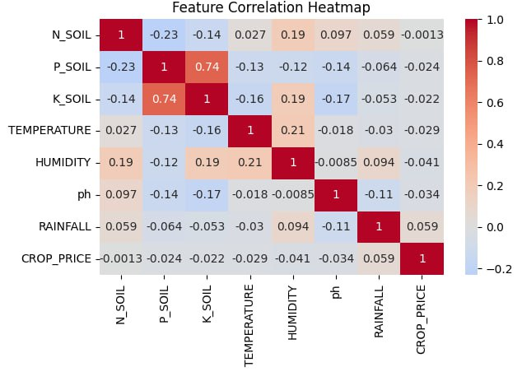
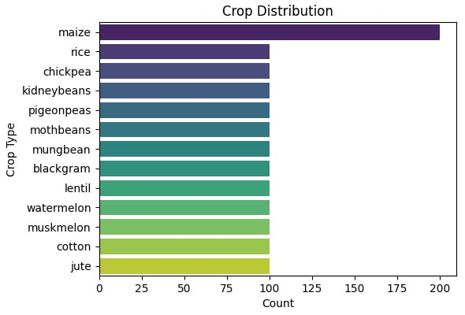
FEATURE ANALYSIS

Slide 13
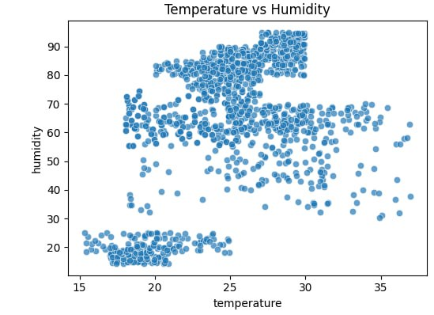
FEATURE ANALYSIS

Slide 14
Performance Analysis and Comparison
Model | Accuracy (%) | Precision | Recall | F1-Score | RMSE | R² Score
Linear Regression | 82.3 | 0.8vu1 | 0.79 | 0.80 | 245.6 | 0.823
Decision Tree | 89.5 | 0.88 | 0.87 | 0.88 | 189.3 | 0.895
Random Forest | 94.2 | 0.93 | 0.92 | 0.93 | 132.7 | 0.942
Gradient Boosting | 95.8 | 0.95 | 0.94 | 0.95 | 118.4 | 0.958
XGBoost | 96.1 | 0.96 | 0.95 | 0.96 | 105.8 | 0.961
Extra Trees (Proposed) | 97.5 | 0.97 | 0.96 | 0.97 | 89.2 | 0.975
Model | Accuracy Improvement | RMSE Reduction | R² Improvement
Decision Tree | +7.2% | -56.3 | +0.072
Random Forest | +11.9% | -112.9 | +0.119
Gradient Boosting | +13.5% | -127.2 | +0.135
XGBoost | +13.8% | -139.8 | +0.138
Extra Trees (Proposed) | +15.2% | -156.4 | +0.152

Slide 15


Conclusion
Crop Yield Prediction is a powerful tool that helps farmers, researchers, and governments plan better
These systems improve food security, reduce losses, and support smart farming.
As technology advances, yield predictions are becoming more accurate, faster, and easier to use — even on mobile phones.
In the future, crop yield predictors will play a key role in making farming more efficient, sustainable, and profitable.

Slide 16
THANK YOU

